Slide 1
Impact of Socioeconomic Status on Academic Achievement Across the United States
DS2500
Professor Rush Sanghrajka
Isabella Caruz, Elda Gobena, Abigail Sandquist
3 December 2024

Slide 2


TABLE OF CONTENTS
1
2
3
4
Problem Statement
Rural vs. Urban
Analysis
Personal Income Analysis
Additional Resources Analysis
5
6
Future Work and Conclusion
Poverty Analysis

Slide 3
1
Problem Statement

Slide 4
Problem Statement
This project aims to explore how socioeconomic status (SES) affects academic achievement across various states in the U.S. We will analyze metrics such as personal income, education resource, poverty levels, and geographical location to understand how these differences can contribute to educational outcomes.

Slide 5
2
Rural VS. Urban
What are the differences between urban and rural areas and the correlations with academic achievement?

Slide 6
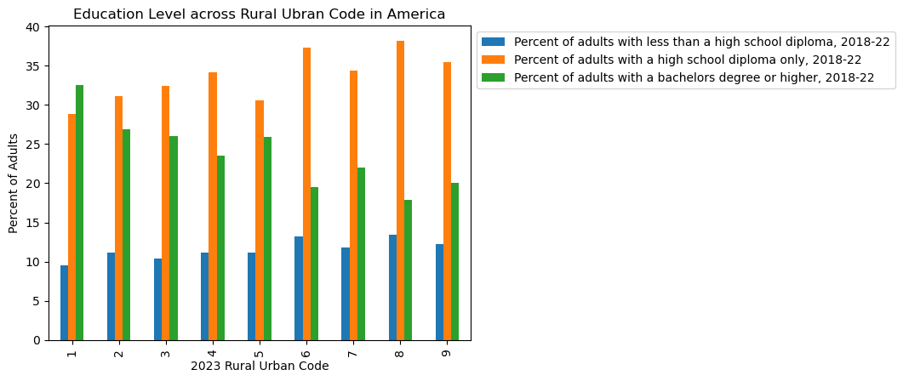
Data Analysis
0.194 = weak positive correlation between urban/rural living and percent of adults with less than a high school diploma
0.358 = weak positive correlation between urban / rural living and percent of adults with only a high school diploma
-0.433 = moderate negative correlation between urban/rural living and the percent of adults with a bachelor degree or higher

Slide 7
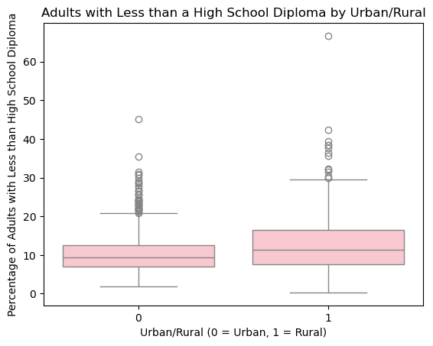
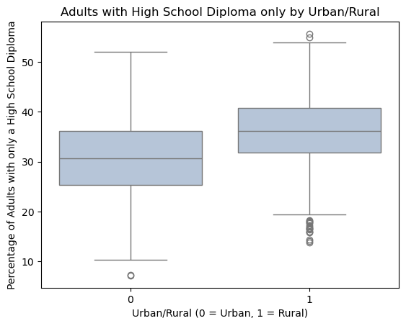
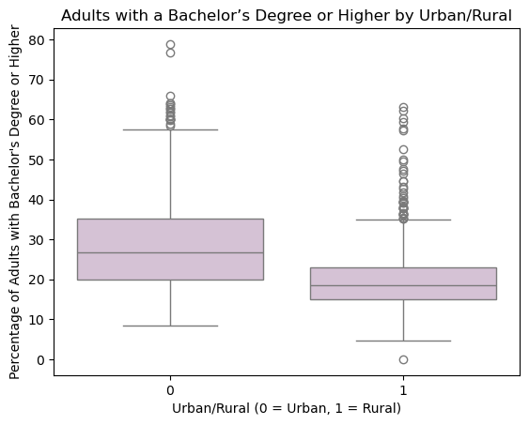
H0 : There is no statistical significance between the two groups
Based on the p value we can reject the null hypothesis
P <0.05
P <0.05
P <0.05

Slide 8
3
Personal Income and Education
Are people living in states with a larger average personal income more likely to pursue advanced degrees?
How does this change throughout different years?

Slide 9
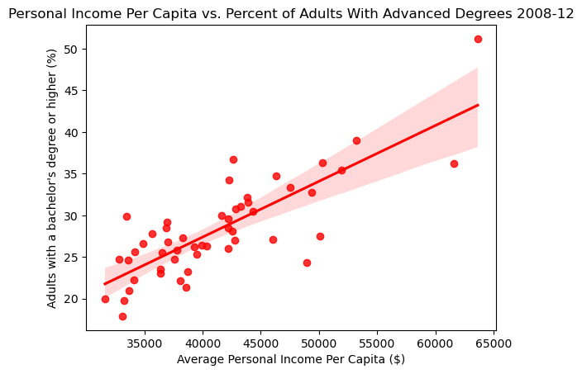
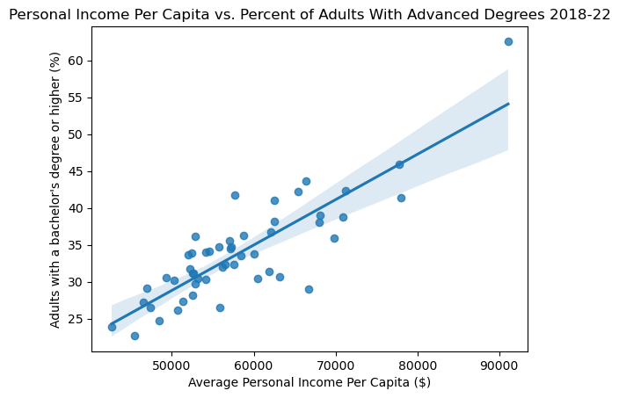
Advanced Degrees and Personal Income Analysis
Correlation: 0.8047352008429198 Correlation: 0.8483246813582825
There is a strong, positive correlation between personal income per capita and the percent of adults with an advanced degree or higher, for two different time periods

Slide 10
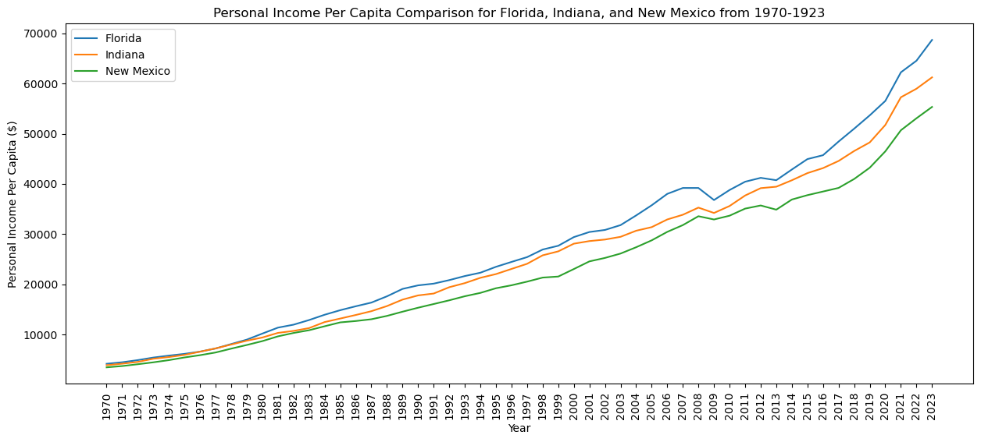
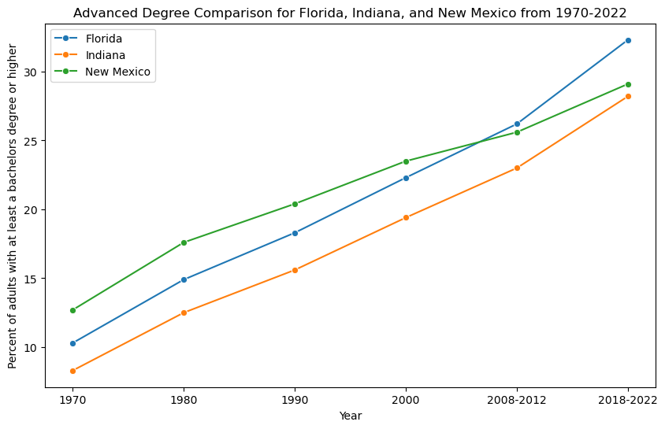
Advanced Degrees and Personal Income Analysis
Generally as personal income per capita increases there the percentage of adults that had pursued a bachelor’s degree or higher increases as well

Slide 11
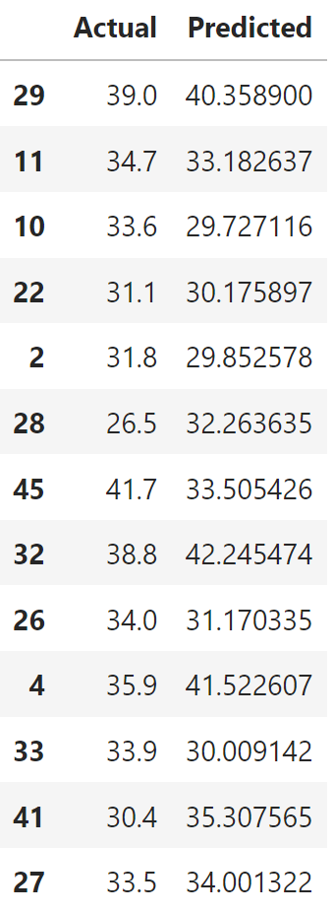
Linear Regression Model Predictions
NH
HI
GA
MI
AZ
NV
VT
NY
MT
CA
NC
SD
NE
Predicting the percentage of adults with an advanced degree for each state during 2018-2022, using personal income per capita data for each state.

Slide 12
4
Additional Resources and Education
How does the use of educational resources affect education?

Slide 13
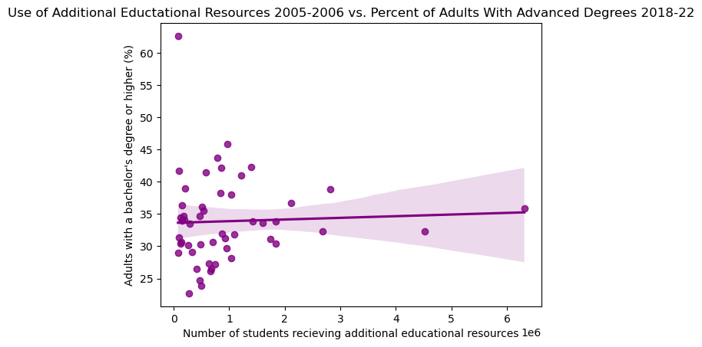
Effect of Additional Educational Resources
Advanced Degrees
Correlation: 0.04339245783784156

Slide 14
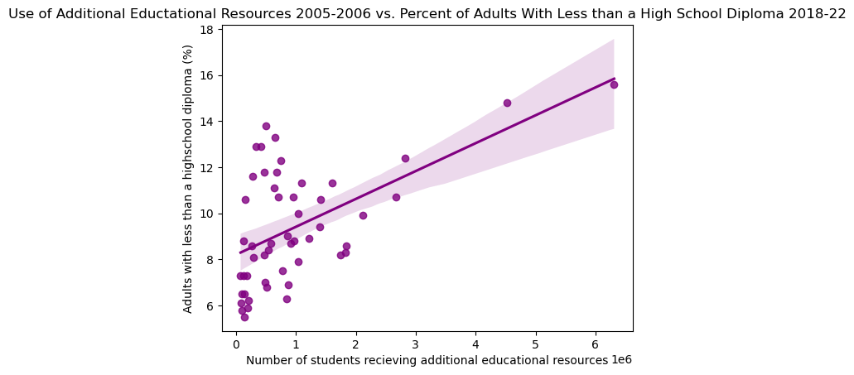
Effect of Additional Educational Resources
Less than High School Diploma
Correlation: 0.5463593779625723
Notes:
May seem counter intuitive, but could reflect that while resources are being allocated, they may not be effectively addressing the root causes of low educational attainment and factors such as socioeconomic status might be playing a more significant role

Slide 15
5
Poverty and Education
How are high school dropout rates correlated with poverty levels across Massachusetts counties, and what insights can be drawn about the impact of socioeconomic status on educational achievement?

Slide 16
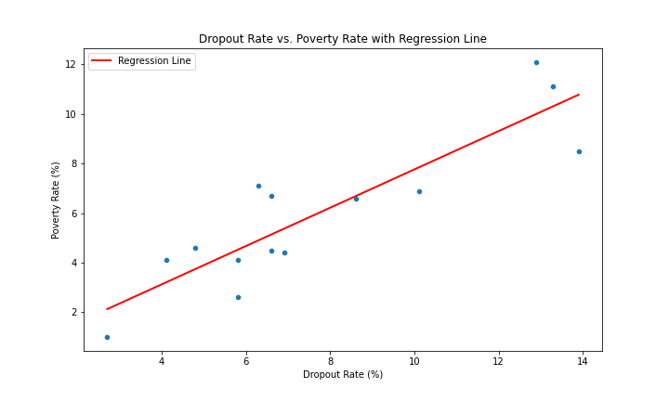
Linear Regression Analysis
Massachusetts County
Poverty Rate vs. Dropout Rate
from 2018-2022
R-value: 0.8864
R-squared: 0.7856
Mean Squared Error: 1.8815
Notes:
R (Correlation Coefficient): 0.8864
This is the Pearson correlation coefficient (rrr), which indicates the strength and direction of the linear relationship between the dropout rate and poverty rate.
A value of r=0.8864r = 0.8864r=0.8864 suggests a strong positive correlation, meaning that as the dropout rate increases, the poverty rate tends to increase as well.
R-squared: 0.7856
This is the coefficient of determination (R2R^2R2), which explains the proportion of variance in the dependent variable (poverty rate) that can be predicted from the independent variable (dropout rate).
An R2=0.7856R^2 = 0.7856R2=0.7856 means 78.56% of the variation in poverty rates is explained by the dropout rates, which is a high explanatory power for the regression model.
Mean Squared Error (MSE): 1.8815
This measures the average squared difference between the observed and predicted poverty rates.
A lower MSE indicates better model performance. Here, an MSE of 1.8815 is relatively low, suggesting the predictions from the regression model are close to the actual data points.

Slide 17
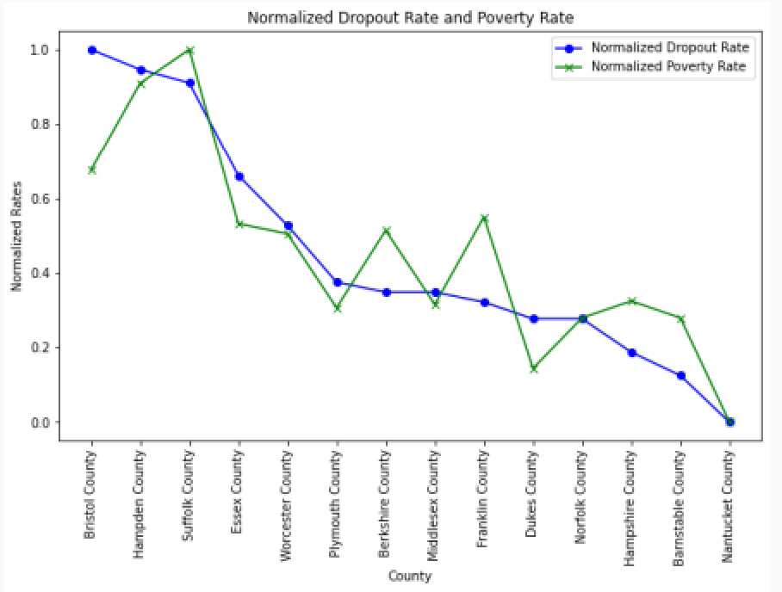
Normalized Rate Analysis
Massachusetts County
Poverty Rate vs. Dropout Rate
from 2018-2022

Slide 18
6
Future Work and Conclusion

Slide 19
Future Work
EXPAND
GEOGRAPHIC SCOPE
URBAN VS RURAL DISPARITIES
LONGITUDINAL ANALYSIS
Analyze additional states/counties to compare SES impacts on dropout rates and academic achievement.
Track changes in personal income and policies over time to understand their effect on advanced degree attainment.
Explore how educational resources and teacher quality differ between urban and rural schools and their impact on achievement.

Slide 20
Conclusion
Key Findings:
A statistically significant relationship exists between urban and rural living and the highest level of degree attainment.
Lower income levels are strongly associated with a decreased percentage of adults holding higher education degrees.
In Massachusetts counties, high poverty levels are closely linked to elevated high school dropout rates.
These findings highlight critical disparities within the education system. Addressing these inequities is essential to fostering equal opportunities and creating a more inclusive society.
Notes:
We found that socioeconomic status based on living in rural vs urban communities, average personal income, receiving educational resources, and poverty rates has a key impact on the education system and a person’s success in education across the United States.

